Slide 1
COMP SCI 2103/7103 Algorithm Design & Data Structure
Lecture 6 – Recursion Practice

Slide 2
Review concept video: Recursive function
Is there a correct base case?
int factorial(n) {
// base case
if (n<2)
return 1;
// recursive case
return (n * factorial(n-1));
}
Is the subproblem closer to the base case?
If the subproblem returns the correct answer, will our combined answer be correct?

Slide 3
Work through these problems (discuss with others and compare your solutions).
As you solve a problem, submit it through Echo 360
Easy problems:
Write a recursive function to sum the integers from 1 to n
Write a recursive function that implements x^n (ie 2^3 = 2 * 2 * 2)
Write a function to calculate greatest common divisor (GCD) of positive integers using Euclid’s algorithm: gcd(a, b) = gcd(b, a mod b) and gcd(a, 0) = a;

Slide 4
More practice
Medium problems
Write a recursive function to sum the digits in an integer (ie 362 would return 11 ie 3+6+2 )
Write a recursive function to reverse a string
Harder problems
Write a recursive function to check whether a string is a palindrome
Write a recursive function to compute: f(n) = 1 x 2 + 2 x 3 + 3 x 4 + … + (n-1) x n

Slide 5
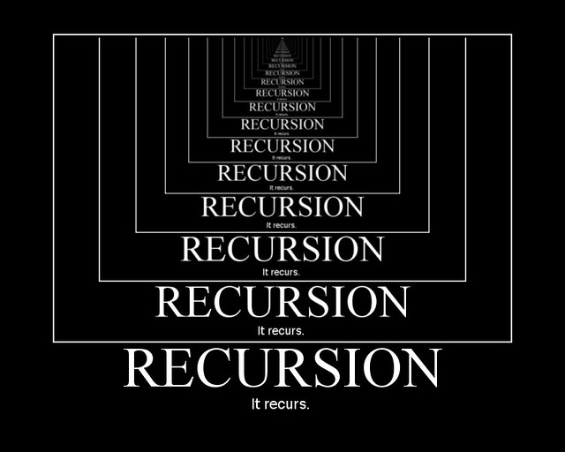
After this lecture….
Look at other solutions to see how peers solved the recursion
Do they meet the 3 criteria
Base case
Recursive call input (subproblem) is closer to base case
Result from recursive call is used to combine subproblem solution into complete solution
Don’t memorise code for these specific problems, work to identify how the code achieves each of the above criteria so you can work with other problems.
This Photo by Unknown Author is licensed under CC BY-SA

